Slide 1
Advanced JAVA Programming
Unit No.6 Servlet

Slide 2
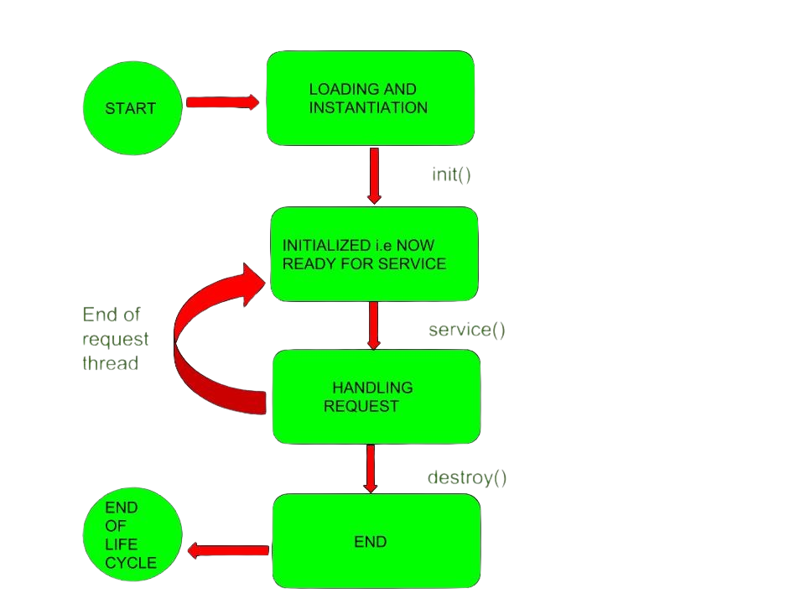
Servlet Life Cycle

Slide 3
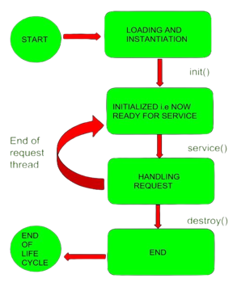
Servlet Life Cycle
life cycle of a Servlet is managed by the Servlet container which uses the javax.servlet.Servlet interface to understand the Servlet object and manage it.
So, before creating a Servlet object, let’s first understand the life cycle of the Servlet object which is actually understanding how the Servlet container manages the Servlet object.
Servlet Life Cycle: The Servlet life cycle mainly goes through four stages,
Loading a Servlet.
Initializing the Servlet.
Request handling.
Destroying the Servlet.

Slide 4
1. Loading a Servlet
The first stage of the Servlet lifecycle involves loading and initializing the Servlet by the Servlet container.
The Servlet container performs two operations in this stage
Loading : Loads the Servlet class.
Instantiation : Creates an instance of the Servlet. To create a new instance of the Servlet, the container uses the no-argument constructor.

Slide 5
2. Initializing a Servlet
After the Servlet is instantiated successfully, the Servlet container initializes the instantiated Servlet object.
container initializes the Servlet object by invoking the Servlet.init(ServletConfig) method which accepts ServletConfig object reference as parameter.
This method is used to initialize the resources, such as JDBC datasource.
if the Servlet fails to initialize, then it informs the Servlet container by throwing the ServletException or UnavailableException.

Slide 6
3. Handling Request
After initialization, the Servlet instance is ready to serve the client requests.
Servlet container performs the following operations when the Servlet instance is located to service a request :
It creates the ServletRequest and ServletResponse objects.
if this is a HTTP request, then the Web container creates HttpServletRequest and HttpServletResponse objects which are subtypes of the ServletRequest and ServletResponse objects respectively.

Slide 7
3. Handling Request
After creating the request and response objects it invokes the Servlet.service(ServletRequest, ServletResponse) method by passing the request and response objects.
service() method while processing the request may throw the ServletException or UnavailableException or IOException.

Slide 8
Destroying a Servlet
After currently running threads have completed their jobs, the Servlet container calls the destroy() method on the Servlet instance.
After the destroy() method is executed, the Servlet container releases all the references of this Servlet instance so that it becomes eligible for garbage collection.

Slide 9
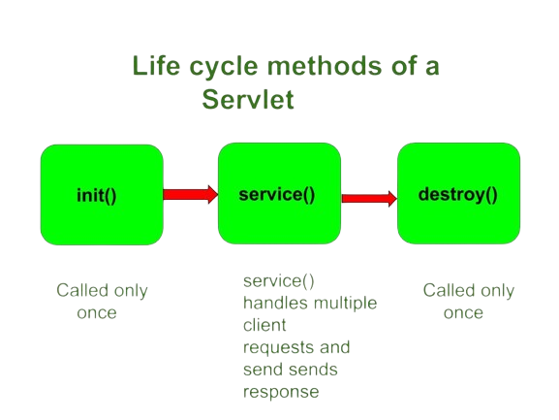
Servlet Life Cycle Method
There are three life cycle methods of a Servlet :
init()
service()
destroy()

